Slide 1
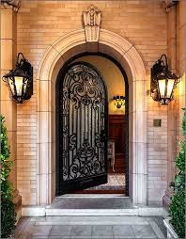
CRITICAL ANALYSIS OF DOORS
HAMDAH NOOR
ARCHITECT

Slide 2
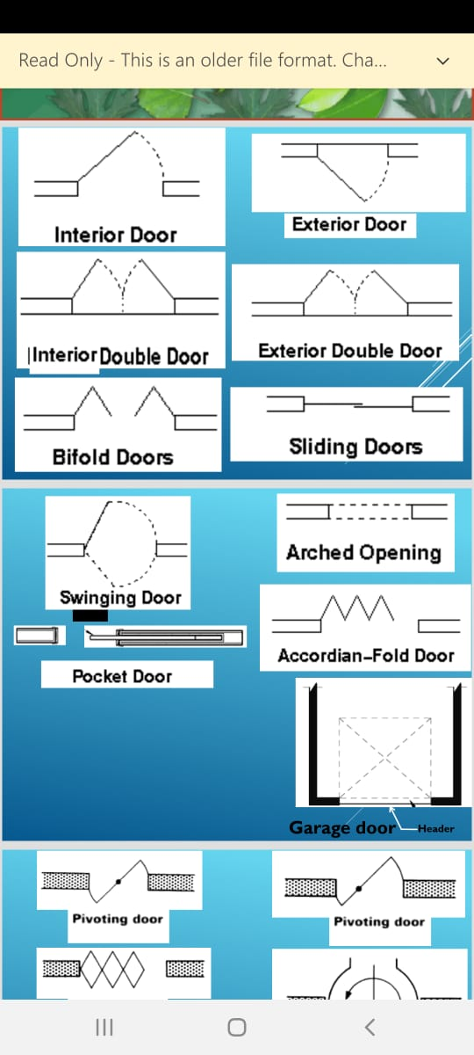
MAIN GATE
The type of my door is
double exterior door
Width of my main door is 14 feet
Height is 8 feet
The material used is of steel
My review for my main door is not good due unsuitable for cars parking and crossing of motor bike

Slide 3
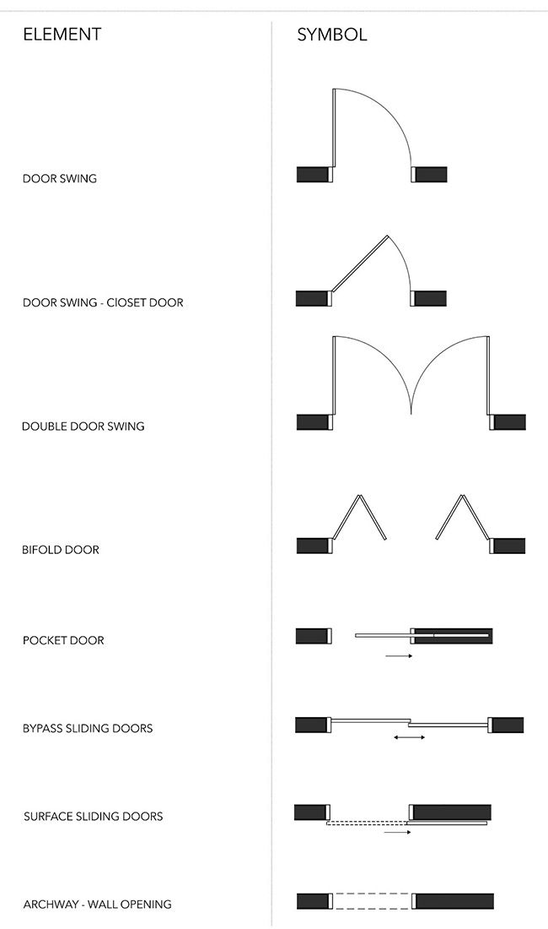
Entrance Door
The type of my door is interior and frame door
Width of my main door is 4 feet
Height is 7 feet
The material used is of plywood
My review for entrance door is good

Slide 4
DINNING DOOR
The type of my door is door swing , frame door and interior door
Width of my main door is 3 feet
Height is 7 feet
The material used is of frame plywood
My review for dinning door is not good because at a time only 2 person pass out. It should be atleast of 3 feet 5 inches

Slide 5
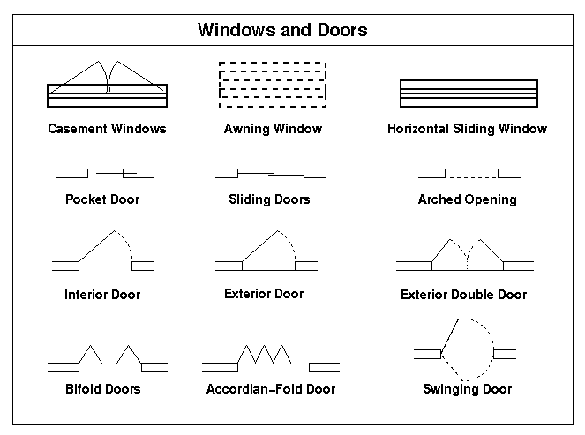
Kitchen door
The type of my door is sliding door
Width of my main door is 4 feet
Height is 7 feet
The material used is of glass
My review for kitchen door is good

Slide 6
BEDROOM DOOR
The type of my door is swing door, interior and frame door
Width of my main door is 3 feet
Height is 7 feet
The material used is of plywood
My review for door is good

Slide 7
Washroom door
The type of my door is door swing and interior door
Width of my main door is 2 feet 6 inches
Height is 7 feet
The material used is of plywood
My review for bathroom door is not good because the space is tight for handicap person

Slide 8
Storeroom door
The type of my door is interior and swing door
Width of my main door is 2 feet 5 inches
Height is 7 feet
The material used is of plywood
My review for storeroom door is not good because it is at least 3 feet 5 inches

Slide 9
Back door
The type of my door is sick door
Width of my main door is 2 feet
Height is 6 feet 5 inches
The material used is of steel
My review for back door is not good because first its not on standard size and the height is small

Slide 10
THANKYOU

